Slide 1
Safety-critical Control in Mixed Criticality Embedded Systems
A Study on Mixed Criticality in the Automotive Industry

Slide 2
Presentation outline
Background
Research question and problem statement
Implementation
Results
Conclusion
Future work

Slide 3
Project group
Develop a demonstrator that simulates platooning
Five master thesis students
Control theory
Lane detection
Data aggregation
Communication
Safety-critical control in MCS

Slide 4
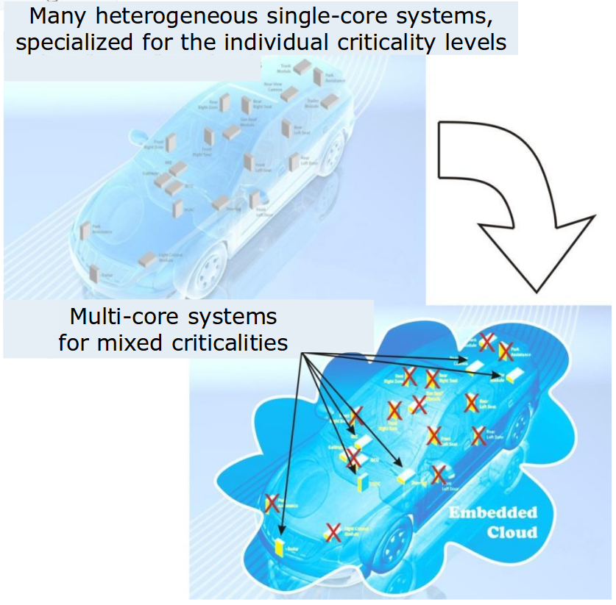
Mixed criticality systems
Modern cars have ~100 ECUs
Clear separation between functions
Inefficient resource usage
Moving toward MCS would mean:
Efficient resource usage
Difficult to separate functions of different criticality
Illustration of combining applications to reduce ECUs [1].

Slide 5
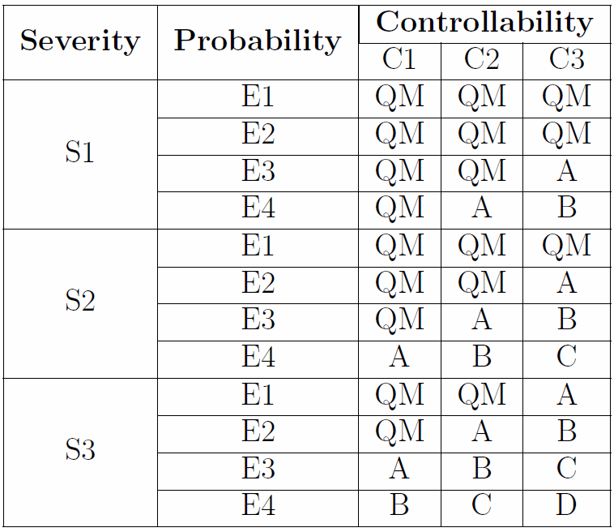
ISO 26262
Four different Automotive Safety Integrity Levels, ASILs
Table of ASIL as a function of Severity, Probability an Controllability [3]

Slide 6
Schedulers
Steve Vestal showed that neither RM nor DM was optimal when criticality levels are introduced.
Sanjoy Baruah and Steve Vestal showed that EDF does not dominate FP in mixed criticality systems.

Slide 7
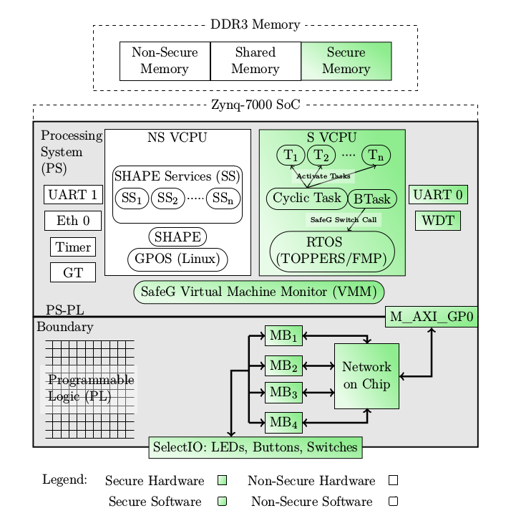
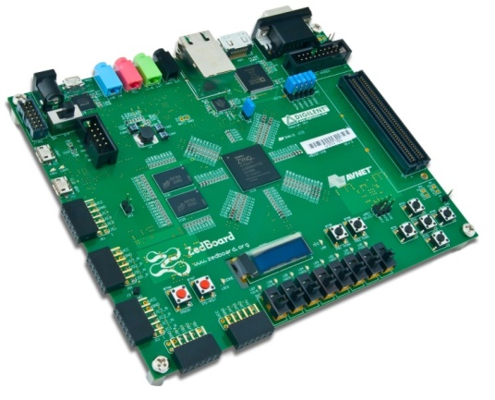
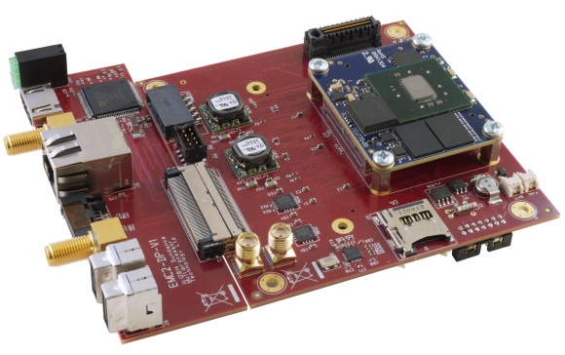
Alten MCS
Zedboard
Alten MCS overview [3]
EMC2DP

Slide 8
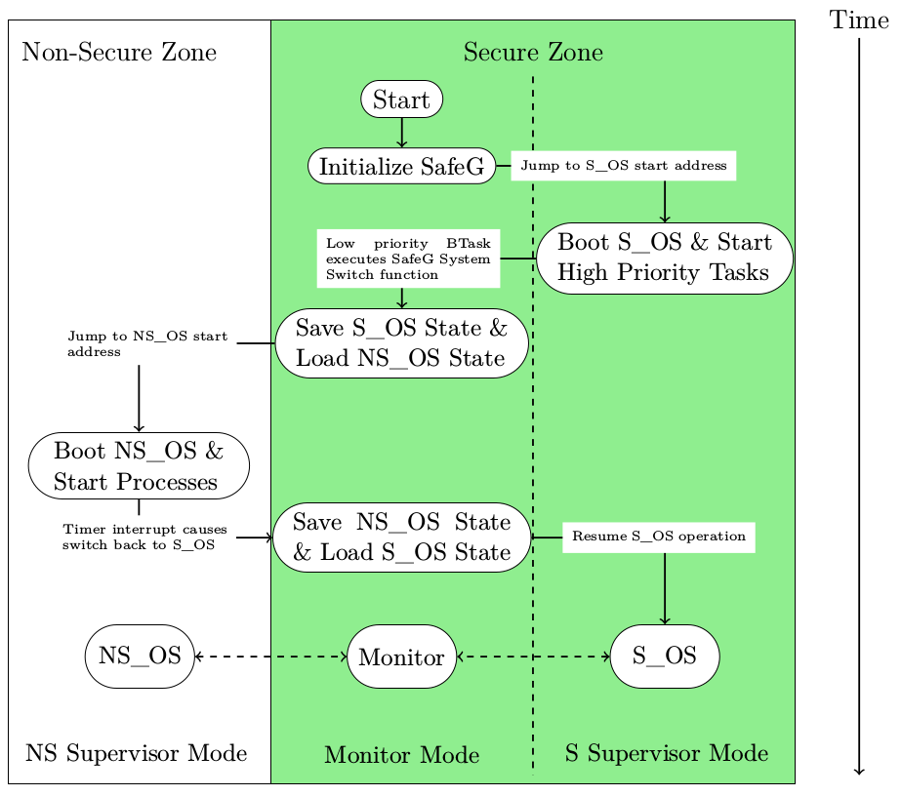
Alten MCS – Processor switching state
Processor boot sequence [3]

Slide 9
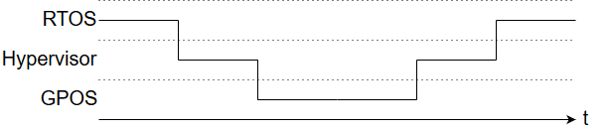
Alten MCS – Processor switching state
Mode switch takes ~2 μs

Slide 10
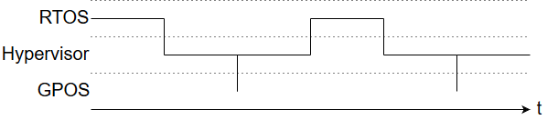
Alten MCS – Processor switching state
Mode switch takes ~2 μs

Slide 11
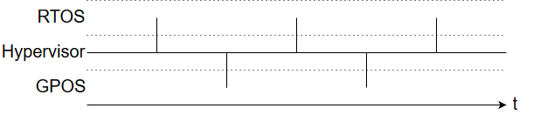
Alten MCS – Processor switching state
Theoretical maximum frequency of 250 kHz

Slide 12
Research question
Is virtualization a good approach when trying to reconcile
the conflicting requirements of partitioning for safety assurance and sharing for efficient resource usage when implementing a safety-critical control system?

Slide 13
Problem statement
Implement the safety-critical applications required for platooning on a mixed criticality system and evaluate the performance of the processor in terms of
Missed deadlines?
Robustness of hypervisor
CPU utilization

Slide 14
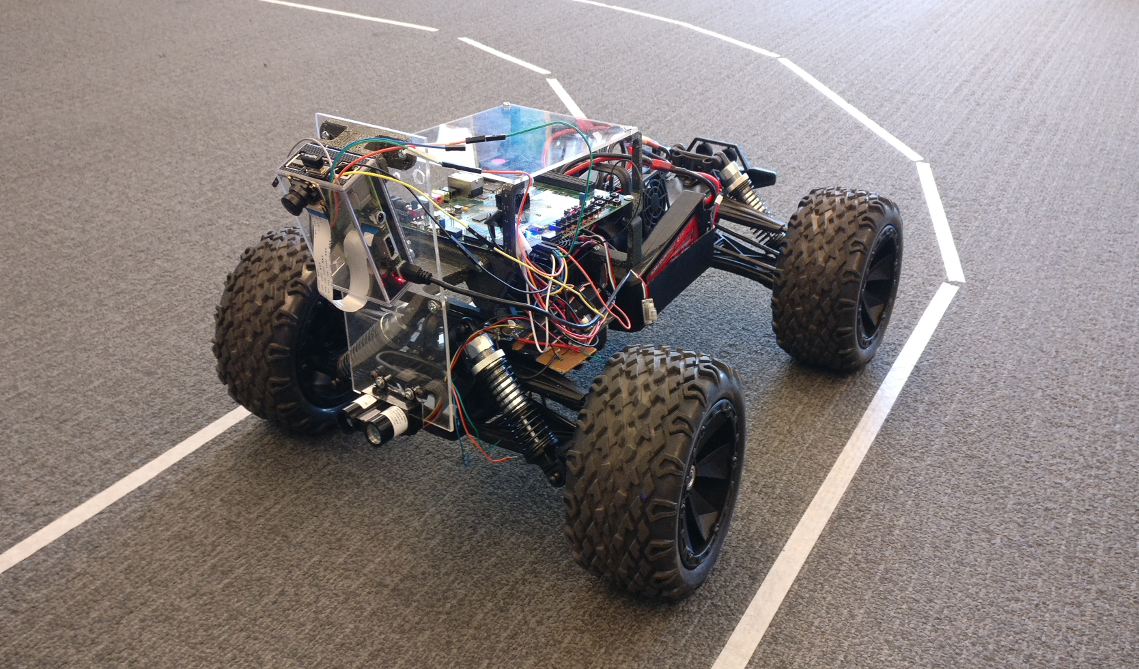
System overview

Slide 15
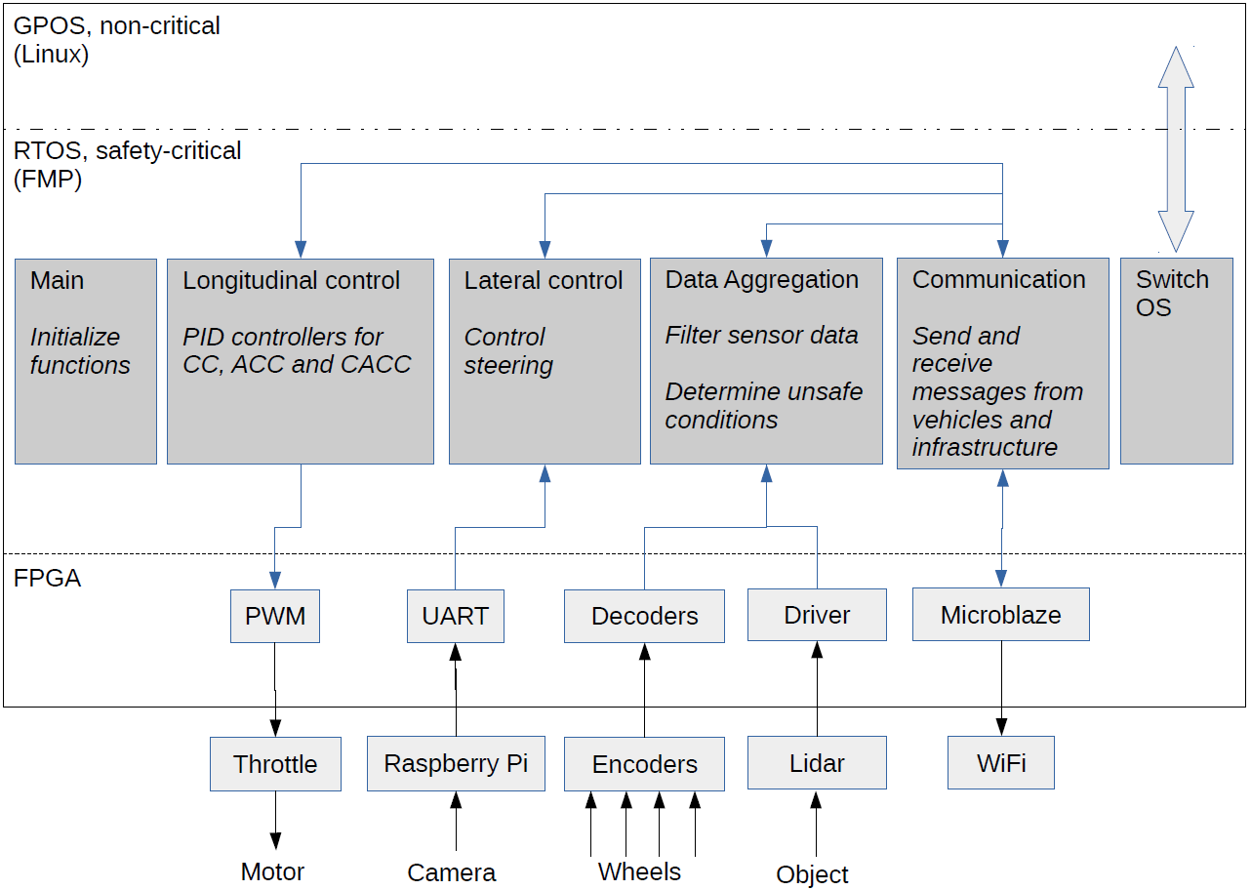
System overview

Slide 16
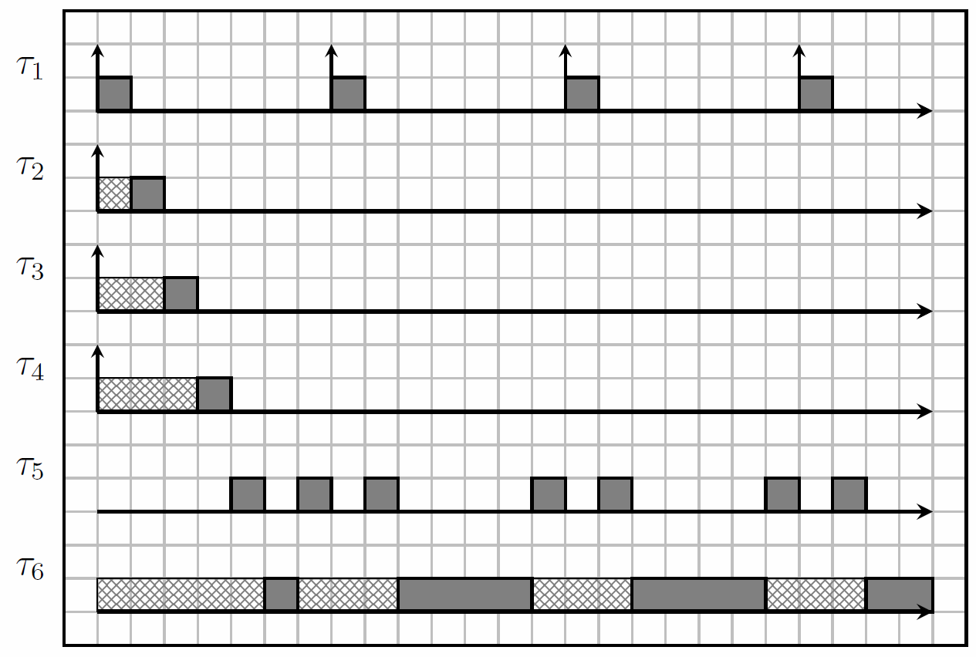
Processor scheduling
Data aggregation
Communication
Lateral control
Longitudinal control
OS switch
GPOS

Slide 17
Demonstrator demonstration

Slide 18
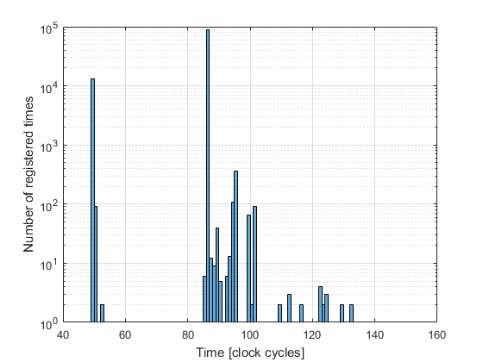
OS switch execution times
WCET
153 clock cycles
3.06 μs
Median execution time
86 clock cycles
1.72 μs
1 kHz switching frequency:
RTOS CPU utilization 0.005%
Hypervisor overhead 0.6%
Increased total CPU utilization to potentially 99.4%

Slide 19
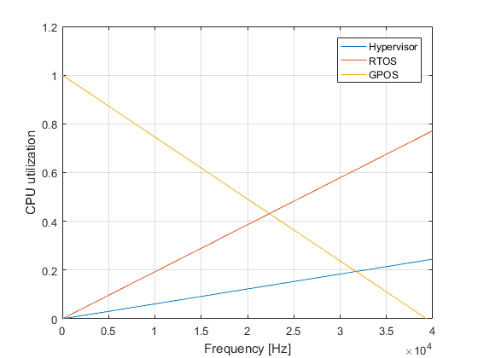
CPU utilization – WCET

Slide 20
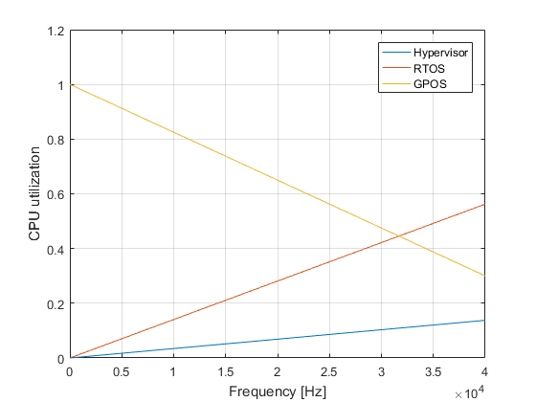
CPU utilization – Median execution time

Slide 21
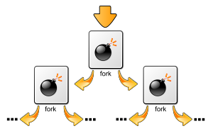
Hypervisor Robustness
Fork bomb
System maintained safety-critical functionality

Slide 22
Conclusion
Is virtualization a good approach when trying to reconcile
the conflicting requirements of partitioning for safety assurance and sharing for efficient resource usage when implementing a safety-critical control system?
Safe (only as safe as the hypervisor)
Enables efficient use of resources
Efficient in the industry as a whole?

Slide 23
Future work
Robustness of the hypervisor must be tested extensively
How many criticality levels would be necessary?
Calculate more accurately the financial effects of MCS

Slide 24
Questions?
References
[1] https://www.artemis-emc2.eu/project_overview/ll1_automotive_applications/
[2] Road vehicles – functional safety – part 9: Automotive safety integrity level (asil)-oriented and safety-oriented analyses. Standard, International Organization for Standardization, Geneva, CH, November 2011.
[3] Youssef Zaki. An embedded multi-core platform for mixed-criticality systems: Study and analysis of virtualization techniques. Master’s thesis, KTH, School of Information and communication Technology (ICT), 2016.
[4] Alan Burns and Robert I. Davis. Mixed criticality systems - a review. July 2016
[5] Steve Vestal. Preemptive scheduling of multi-criticality systems with varying degrees of execution time assurance, 2007.
[6] Sanjoy Baruah and Steve Vestal. Schedulability analysis of sporadic tasks with multiple criticality specifications, 2008.

